Slide 1
JavaScript Continued
AIM Code School
By: Vanessa Kasun

Slide 2
Var, Const, Let...What’s the difference?
Var- the scope is limited to the function within which it is defined. If it is defined outside any function, the scope of the variable is global. Var is “function scoped”
Let- the scope of a variable defined with the keyword “let” or “const” is limited to the “block” defined by curly braces i.e.{}. Let and Const are “block scoped”
Const- The scope of a variable defined with the keyword “const” is limited to the block defined by the curly braces. However, if a variable is defined with a keyword const, it cannot be reassigned. Const cannot be reassigned to a new value. However it CAN be mutated.

Slide 3
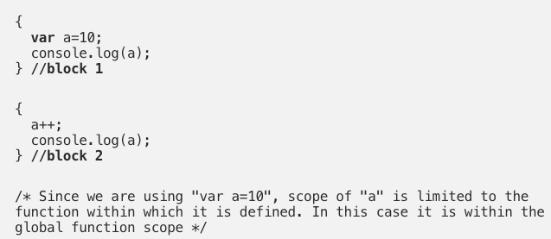
Function scoped vs. Block scoped
Block scope - in JS you can define a code block using curly braces i.e {}. Consider the following code that has 2 code blocks each delimited by the {}.
In the above example, since we are using the keyword var to define the variable a, the scope of a is limited to the function within which it is defined. Since a is not defined within any function, the scope of the variable a is global, which means that a is recognized within block 2.

Slide 4
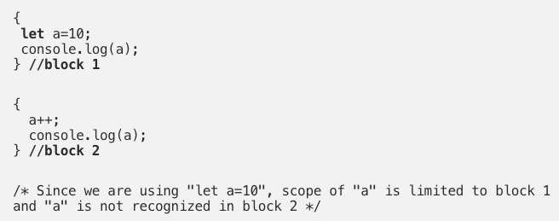
Function scoped vs. Block scoped
Let us rewrite the code above using the keyword let.The let keyword was introduced as part of ES6 syntax, as an alternative to var to define variables in Javascript
Note that now when you run the code above you will get an error, variable a not recognized in block2. This is because we have defined the variable a using the keyword let, which limits the scope of variable a to the code block within which it was defined.

Slide 5
While programming in Javascript it is a good practice not to define variables as global variables. This is because it is possible to inadvertently modify the global variable from anywhere within the Javascript code. To prevent this one needs to ensure that the scope of the variables are limited to the code block within which they need to be executed.
In the past before keyword let was introduced as part of ES6, to circumvent the issue of variable scoping using var, programmers used the IIFE pattern to prevent the pollution of the global namespace. However since the introduction of let, the IIFE pattern is no longer required, and the scope of the variable defined using let is limited to the code block within which it is defined.
What is an IIFE?
IIFE stands for “Immediately Invoked Function Expression”.
In simple terms an IIFE (Immediately Invoked Function Expression) is a Javascript function that is invoked when it is defined.
More information on IIFE with examples

Slide 6
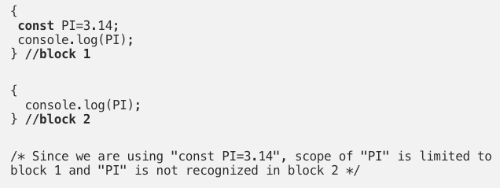
The “const” keyword
As we said before a variable defined using the const keyword, its scope is limited to the block scope. In addition the variable cannot be reassigned to a different value.
Note that it is important to understand that const does NOT mean that the value is fixed and immutable. This is a common misunderstanding amongst many Javascript developers, and they incorrectly mentioned that a value defined by the const keyword is immutable (i.e. it cannot be changed).

Slide 7
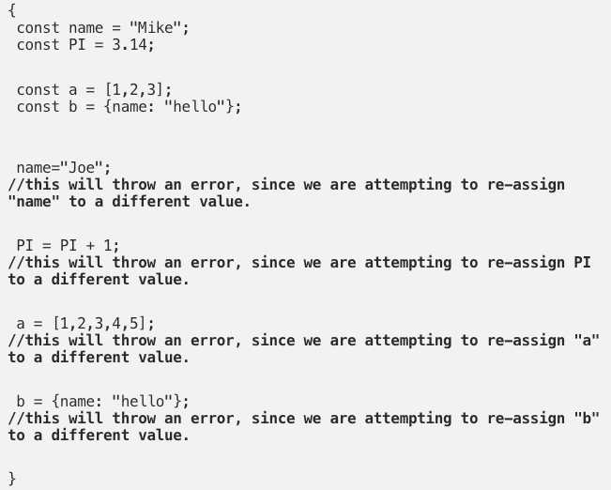
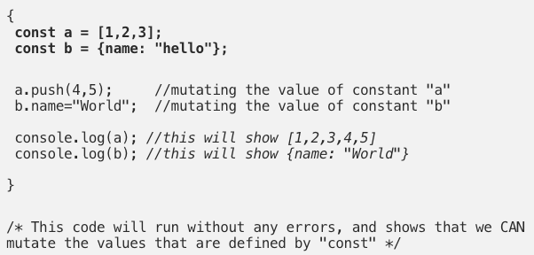
The “const” keyword
In the following example we can show that the value of the variable defined within the const keyword is mutable, i.e. it can be changed.
However note that these variables defined by const cannot be re-assigned.

Slide 8
forEach() method

Slide 9
forEach()
The forEach() method executes a provided function once for each array element.
The forEach method is also used to loop through arrays, but it uses a function differently than the classic "for loop".
The forEach method passes a callback function for each element of an array together with the following parameters:
Current Value(required)
Index(optional)
Array(optional)

Slide 10


forEach() example
Firstly, to loop through an array by using the forEach method, you need a callback function (or anonymous function):
The function will be executed for every single element of the array. It must take at least one parameter which represents the elements of an array:

Slide 11
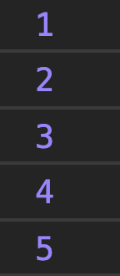
OUTPUT:
That's all we need to do for looping through the array:

Slide 12
document.querySelector() method
The querySelector() method returns the first element that matches a specified CSS selector(s) in the document.
Note: The querySelector() method only returns the first element that matches the specified selectors. To return all the matches, use the querySelectorAll() method instead.
If the selector matches an ID in document that is used several times (Note that an "id" should be unique within a page and should not be used more than once), it returns the first matching element.
W3 querySelector Live Example

Slide 13
JavaScript Event Handlers

Slide 14
Events in JS
HTML events are "things" that happen to HTML elements. When JavaScript is used in HTML pages, JavaScript can "react" on these events.
An HTML event can be something the browser does, or something a user does.
Here are some examples of HTML events:
An HTML web page has finished loading
An HTML input field was changed
An HTML button was clicked
Often, when events happen, you may want to do something.
JavaScript lets you execute code when events are detected.

Slide 15
addEventListener
JavaScript provides an event handler in the form of the addEventListener() method. This handler can be attached to a specific HTML element you wish to monitor events for, and the element can have more than one handler attached.
Target - the HTML element you want to add your event handler to.
Event - a string that specifies the name of the event.
Function - specifies the function to run when the event is detected. This is the magic that can allow your web pages to change dynamically (DOM)
useCapture- an optional boolean value that specifies whether the event should be captured or not..
Live Example

Slide 16
(e)

Slide 17
Understanding the (e) parameter
The parameter (e) is automatically passed from javascript to your function when you add an event listener. It represents the element that was affected, an example would be the button element that was clicked.
We’ll skip seeing a live example of this. It is demonstrated in our Calculator assignment we will be working on today.

